Slide 1


COMP8691: Optimisation
Multi-Agent Path Planning

Slide 2



About the Team
Muhammad Arslan Amjad Qureshi
(u7632488)
Saksham Gupta
(u7726995)
Tohfa Siddika Barbhuiya
(u7665856)

Slide 3
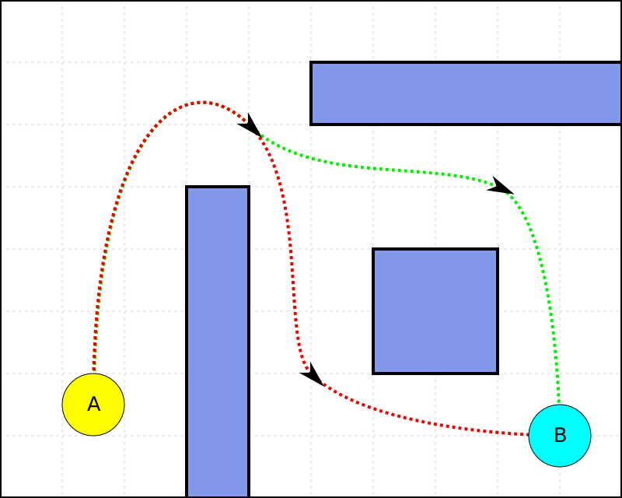
Introduction To Path Finding
Definition: "Pathfinding is the process of determining the most efficient route from a start point to a destination while avoiding obstacles."
Obstacle Avoidance: Navigating around barriers in the environment
Optimisation: Finding the most efficient path possible
. A(Start), B(Destination)

Slide 4
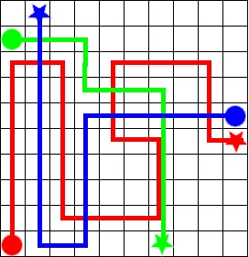
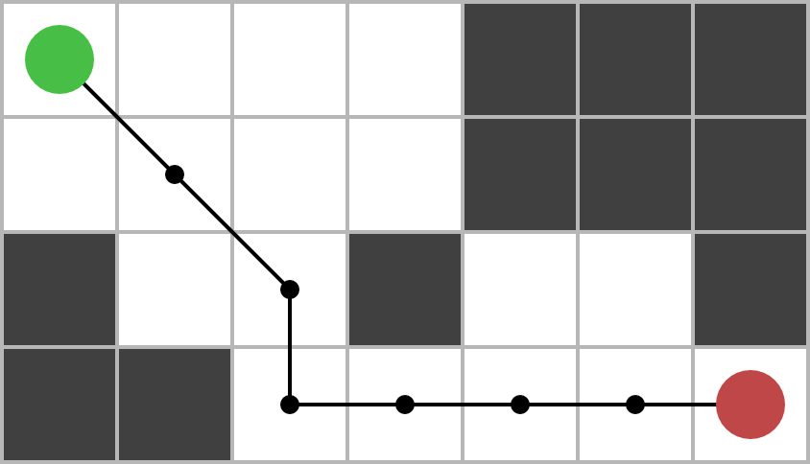
Agent Based Path Planning
Single Agent
Multi Agent
Involves only one agent navigating from start to goal.
Involves multiple agents moving to different goals simultaneously.

Slide 5
Single Agent Path Planning(Techniques)
A* Algorithm
Dijkstra's Algorithm
Description: A* is a pathfinding algorithm that finds the shortest path by combining:
g-cost: Actual cost from the start node.
h-cost: Heuristic estimate of cost to reach the goal.
Heuristic Function (h-cost): Uses estimates like Manhattan or Euclidean distance to prioritize nodes, speeding up the search.
Optimality: A* is optimal when the heuristic is admissible (it never overestimates), ensuring the shortest path is found.
Description: Explores all possible paths from the start to each node, calculating the g-cost (actual cost).
Focus: Lacks a heuristic, so it explores all routes without prioritization.
Optimality: Guarantees the shortest path but is slower than A* in large spaces due to exhaustive exploration.

Slide 6
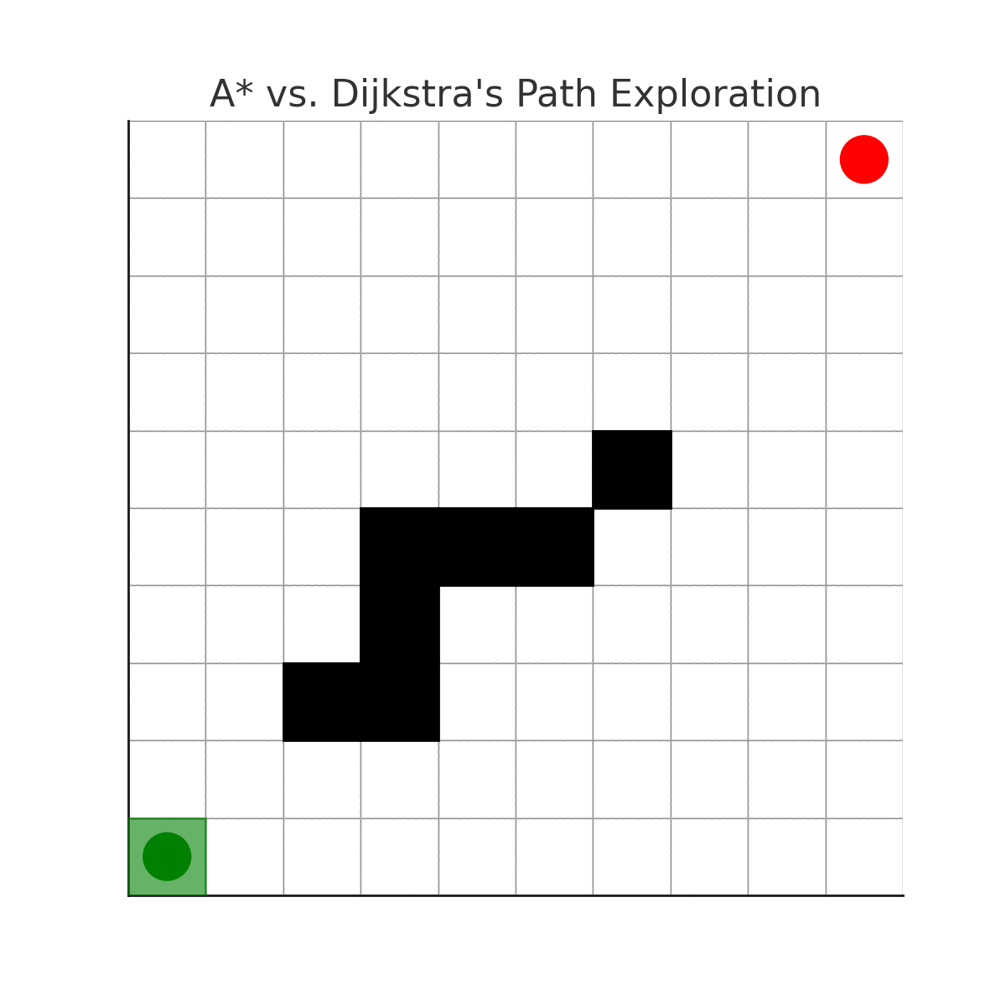
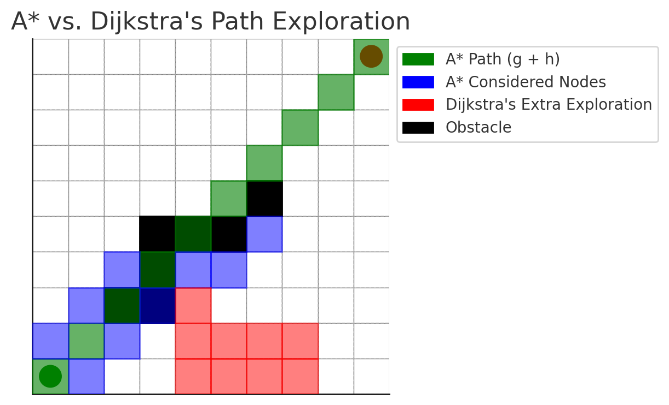
Single Agent Path Planning(A* VS Dijkstra's)
Green squares represent the nodes that A* selects for its path (shortest path using the combined g-cost and heuristic).
Blue squares show additional nodes that A* considered due to its heuristic but did not include in the final path.
Red squares illustrate the extra nodes that Dijkstra's algorithm explores, highlighting its exhaustive nature compared to A*.
Black squares are obstacles that both algorithms need to avoid.

Slide 7
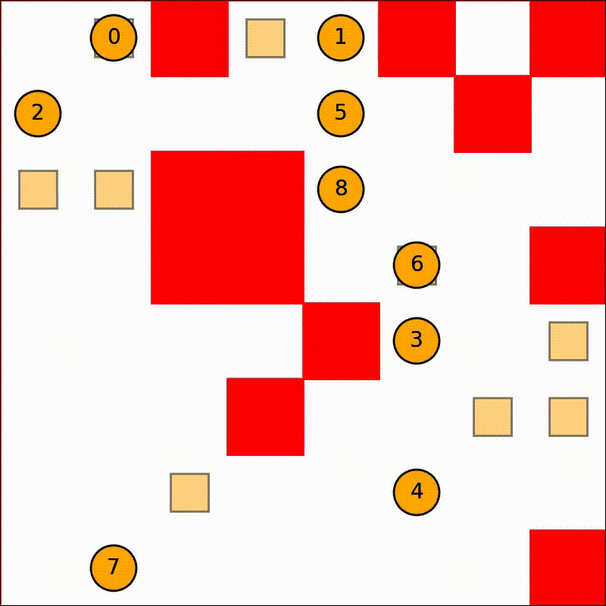
Multi Agent Path Planning
Multi-Agent Pathfinding involves coordinating multiple agents to navigate from their start points to goals without collisions.
Numbered Circles(Agents)
Red Blocks(obstacles)
Light Orange Square Blocks(Destination for each agents)

Slide 8
Types of Multi Agent Path Planning Environments
Static
Dynamic
Definition: Obstacles and the layout remain fixed.
Pathfinding: Precomputed paths are valid for the entire journey.
Definition: Obstacles, agents, or the environment change over time.
Pathfinding: Paths must be recalculated in real-time as changes occur.

Slide 9
Techniques for Multi Agent Path Planning
Technique | Description | Advantages | Disadvantages
Decoupled Planning | Agents plan their paths independently, then adjust if conflicts arise. | Simple to implement, less initial computation. | May lead to suboptimal paths, requires post-adjustment.
Cooperative A* | Agents share their planned paths during the planning phase to avoid collisions. | Minimizes conflicts early on, more efficient paths | Increased computational cost during planning.
Sub-dimensional Expansion(M*) | Expands the search space only locally when potential collisions are detected. | Reduces computational load, efficient collision handling. | Requires dynamic path adjustments during execution.

Slide 10
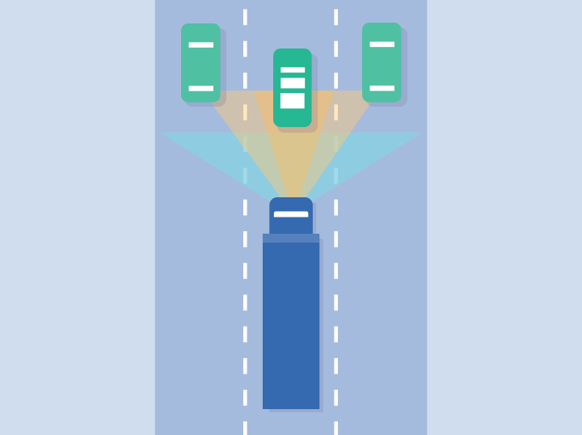
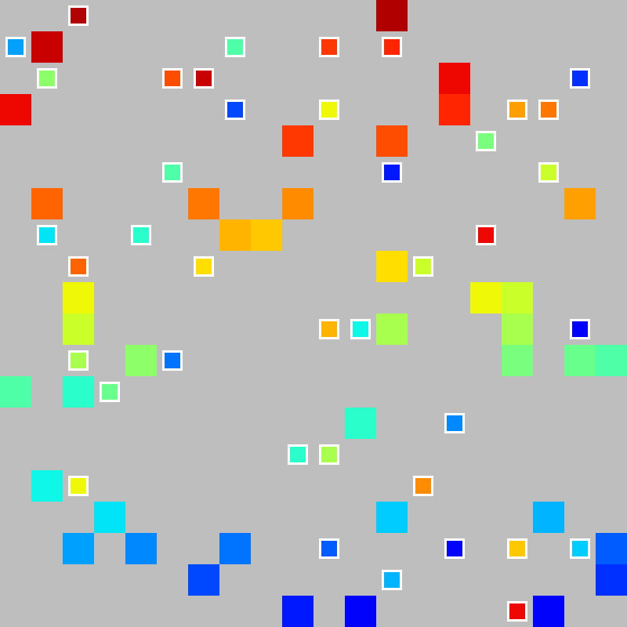
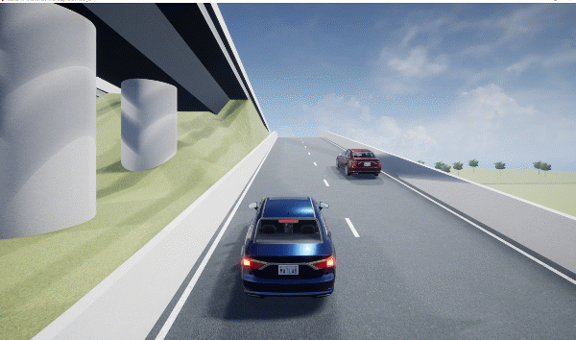
Challenges In Multi Agent Path Planning(Need For Optimisation)
Collision Avoidance:
Deadlocks:
Scalability:

Slide 11
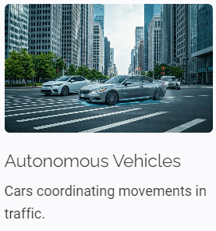

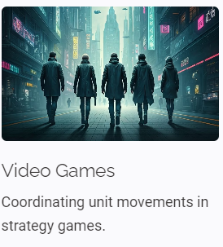
Real-World Applications of Multi-Agent Dynamic Path Planning

Slide 12

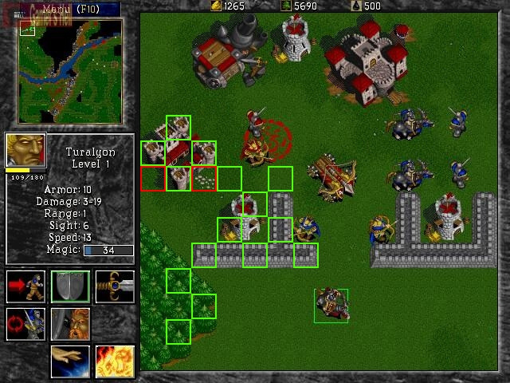
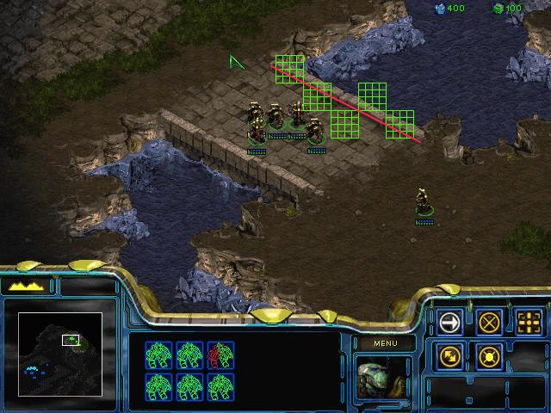
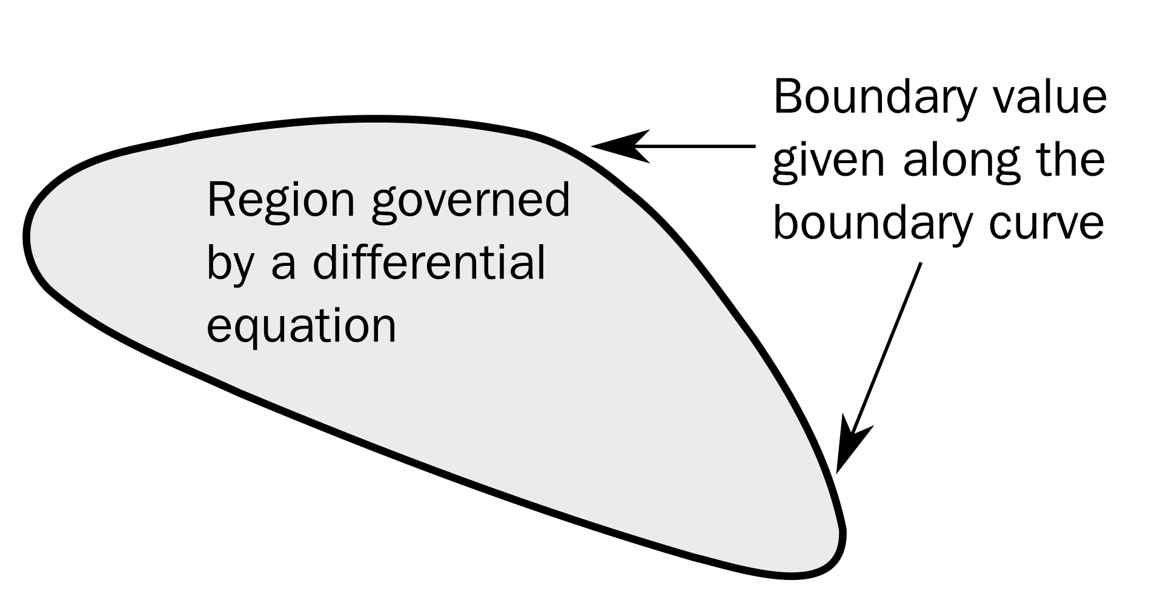
Introduction to Path Planning in RTS Games
1
What is Path Planning?
Dynamic Navigation: Path planning enables units to navigate complex, changing environments efficiently.
Path Planning in Star craft: Where the green isometric shapes were passable while the red ones were not.
2
Why is it important?
In RTS games, agents (e.g., soldiers) need to navigate complex and dynamic environments quickly and efficiently.
3
Real-Time Decision Making
Real-time responsiveness, multiple agents, dynamic obstacles, and ensuring the pathfinding method scales well for large numbers of units.
The BVP Path Planner is designed to address these challenges, providing a smooth and realistic movement for agents.

Slide 13
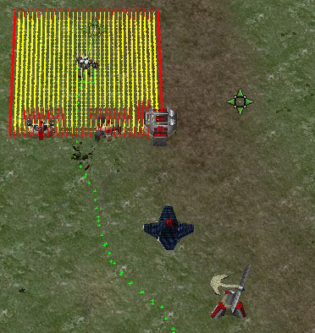

BVP Path Planner Overview
Potential Field Creation
1
The BVP Path Planner uses potential fields to guide agents. Obstacles generate high-potential regions, goals generate low-potential regions.
Agents follow the gradient of the potential field, moving smoothly toward goals while avoiding obstacles.
∇²p(r)=εv⋅∇p(r) : The Poisson equation.
Explanation:
∇²p(r): The Laplacian computes the gradient of the potential field, allowing agents to
move smoothly toward the goal.
εv⋅∇p(r) : A small perturbation that steers agents away from obstacles.
2
Gradient Descent
Agents use gradient descent to optimize their paths.
3
Path Optimisation
By following the gradient, the BVP Path Planner naturally optimizes paths, ensuring that agents take the most direct route while avoiding obstacles.
The path produced by the BVP Path Planner, illustrated by the green dots

Slide 14
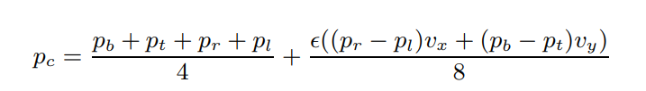
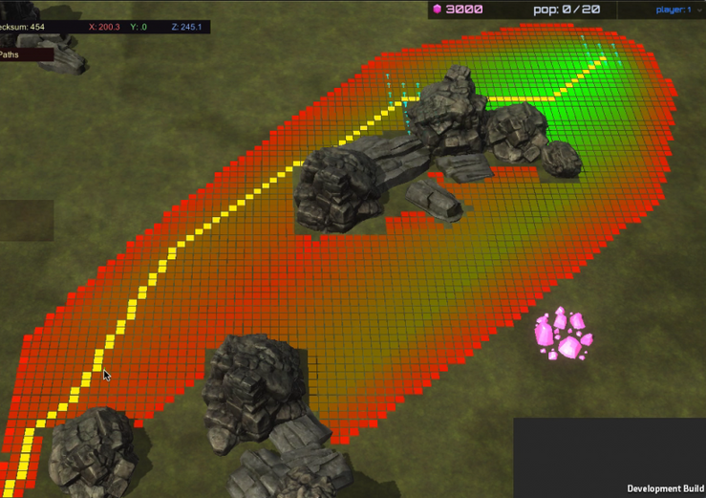
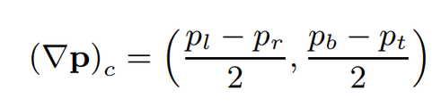
Gauss-Seidel (GS) Method for Path Optimization
The Gauss-Seidel (GS) method is used to compute the potentials of free space cells in the potential field.
This method iteratively updates the potential of each cell using neighboring cells, ensuring that the field converges to an optimized solution.
Practical Application in RTS Games:
In real-time strategy (RTS) games, the GS method allows agents to react to dynamic obstacles and environments. It ensures that agents avoid obstacles while traveling along the shortest path to the goal.
p_{c}​ is the potential at the current cell.
p_{b}, p_{t}, p_{r}, p_{l} are the potentials at the neighboring cells (bottom, top, right, left, respectively).
The second term applies a small perturbation based on the agent’s velocity in the x and y directions (v_{x} , v_{y}) to fine-tune the path.
The gradient of the potential field guides the agent from high-potential (near obstacles) to low-potential areas (towards goals), to its current position (i, j),
This equation calculates the gradient at cell c, guiding the agent’s movement.

Slide 15
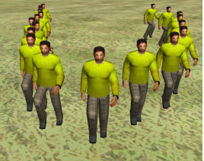
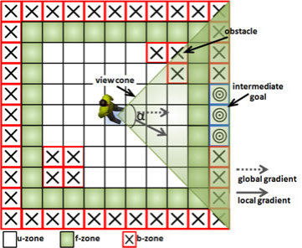
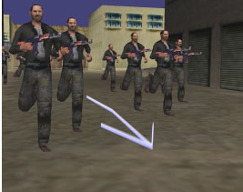
Handling Group and Individual Agents
Global Path Planning
Local Path Adjustments
Adaptive Behavior
Moves groups of agents toward shared goals, ensuring group cohesion.
Each agent has a local map m_{k}​, which contains the agent’s current surroundings.
The local map has three regions:
Update Zone (u-zone): Central area where agents update their path info.
Free Zone (f-zone): Areas without obstacles.
Border Zone (b-zone): Regions near obstacles where path adjustments are necessary.
Each agent updates the potential at its current position based on the values from neighboring cells, ensuring the path is continuously optimized as the agent moves within its local map.

Slide 16
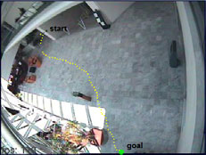

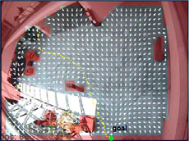



Agent Local Map and Position Updates
Sensing and Local Map Updates
Agents use sensors to detect obstacles within their view cone. Obstacles in the u-zone are assigned a potential value of 1 to guide the agent in avoiding them.
Intermediate Goals and Border Zones
The agent calculates a gradient descent to create an intermediate goal in the b-zone of the local map. Some cells are marked as free (potential=0), and others as obstacles (potential=1).
Position Update and Collision Avoidance
Agents update their position based on orientation and gradient descent. If the agent's direction deviates too much from the goal, it slows down or stops to avoid collisions, ensuring smooth movement toward the target.

Slide 17

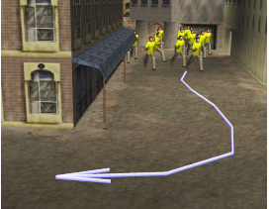


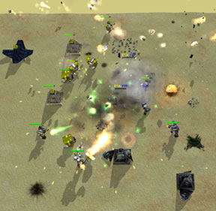

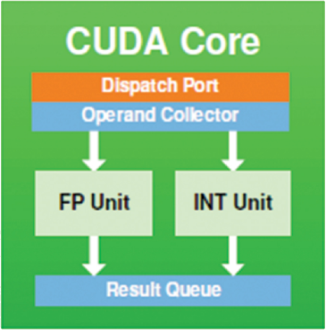
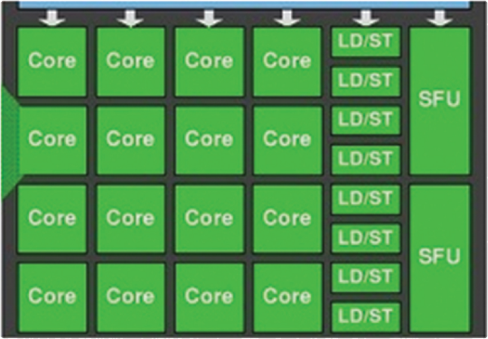

User Interaction in Real-Time Strategy Games
Sketch-Based Path Planning
Players can interact with the game by sketching paths for selected units. The BVP Path Planner converts these sketches into optimised paths, accounting for terrain and obstacles.
The user can interact and
sketch trajectories to be followed
by the groups
Splitting the Army
Players can also split their forces by drawing multiple paths. Units automatically follow these paths, with different groups taking different routes (e.g., soldiers through a swamp, tanks on clear ground).
GPU-Based Speedup
The path planning process is highly parallelizable, using GPU threads to quickly compute potential fields and obstacle updates for each agent, allowing for large-scale battles to run efficiently.
Two autonomous army ﬁghting after splitting up

Slide 18
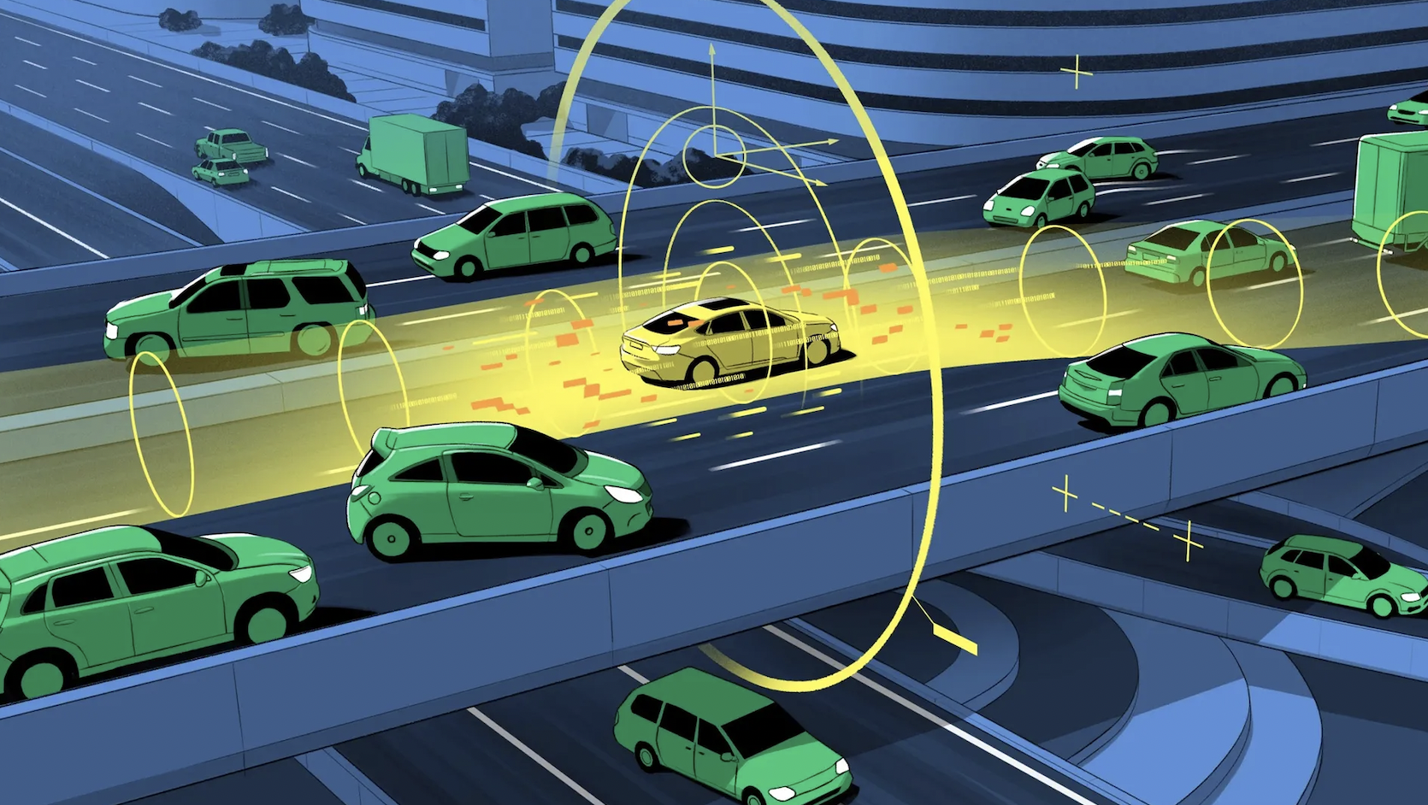

Autonomous vehicles
The process of finding the best solution from a set of feasible solutions, crucial for effective decision-making in autonomous systems. ​
Importance: Autonomous vehicles operate in complex environments and need reliable decision-making frameworks to enhance safety, reduce road fatalities, and improve transportation efficiency.​

Slide 19
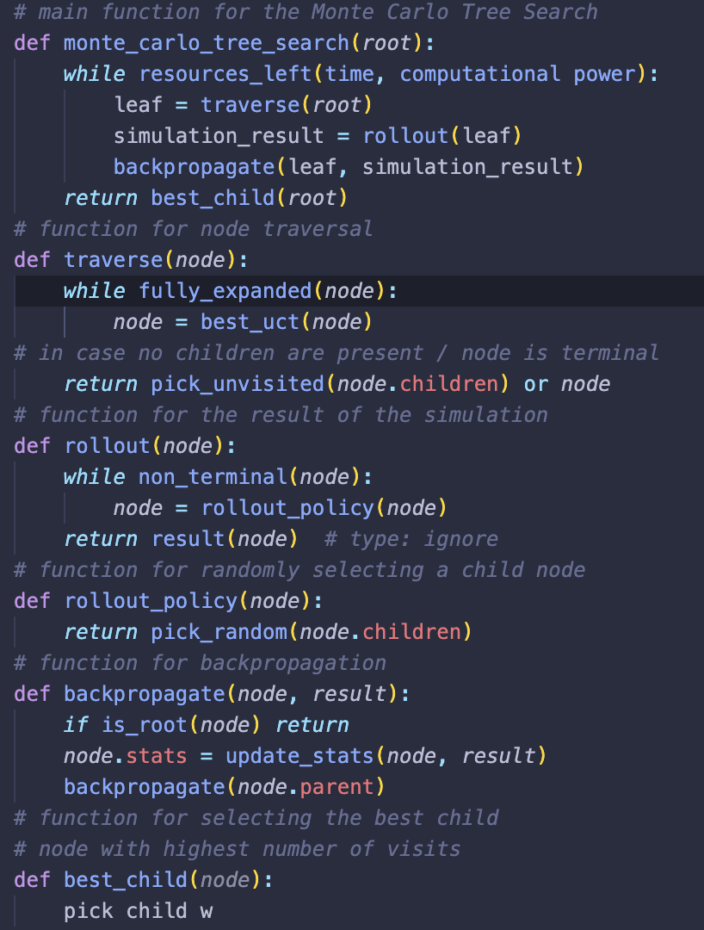
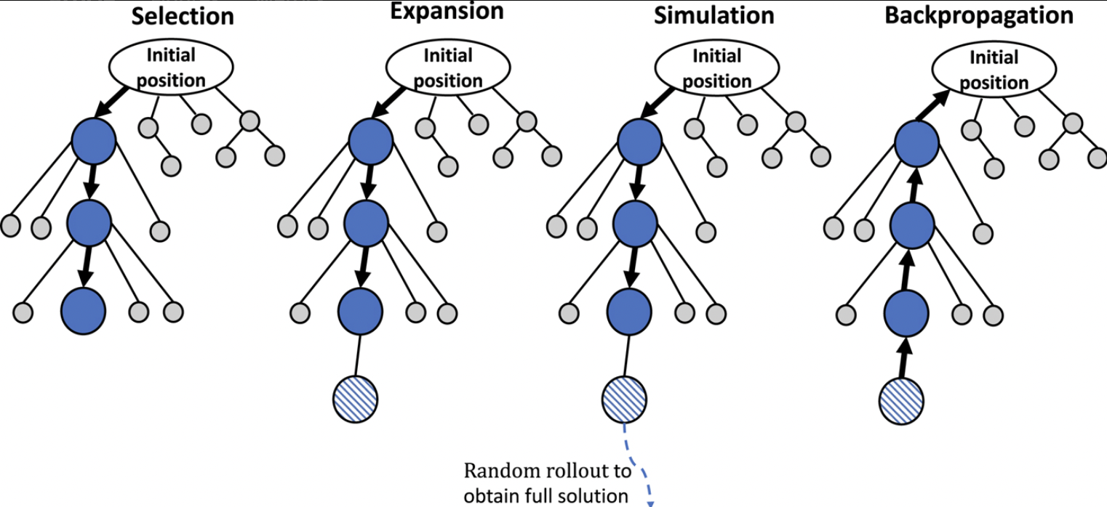
Game-Theoretic Approaches
Multi-agent Interactions: Agents make decisions based on predicting others’ actions.
Utility Maximisation: Each agent aims to maximize their own benefit or reward.
Approaches:
Tree Search and Monte Carlo Tree Search

Slide 20
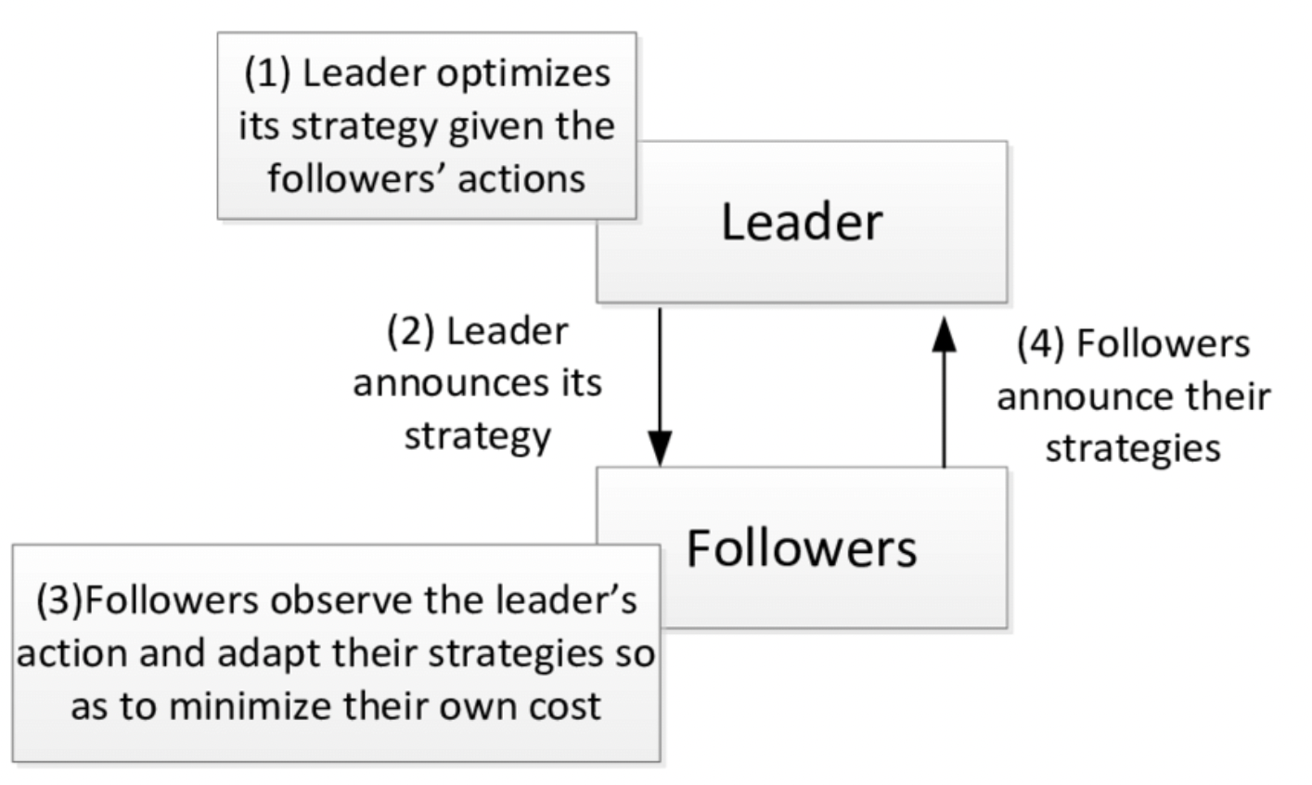
2. Stackelberg Games: A leader-follower model where one agent optimises first, and others react.
It optimises decision-making by allowing the leader vehicle to make the best possible move, while assuming the following vehicles will react in a way that maximizes their own utility. By accounting for the worst-case responses, the leader vehicle can plan robust strategies, reducing decision uncertainty and improving coordination among multiple agents.

Slide 21
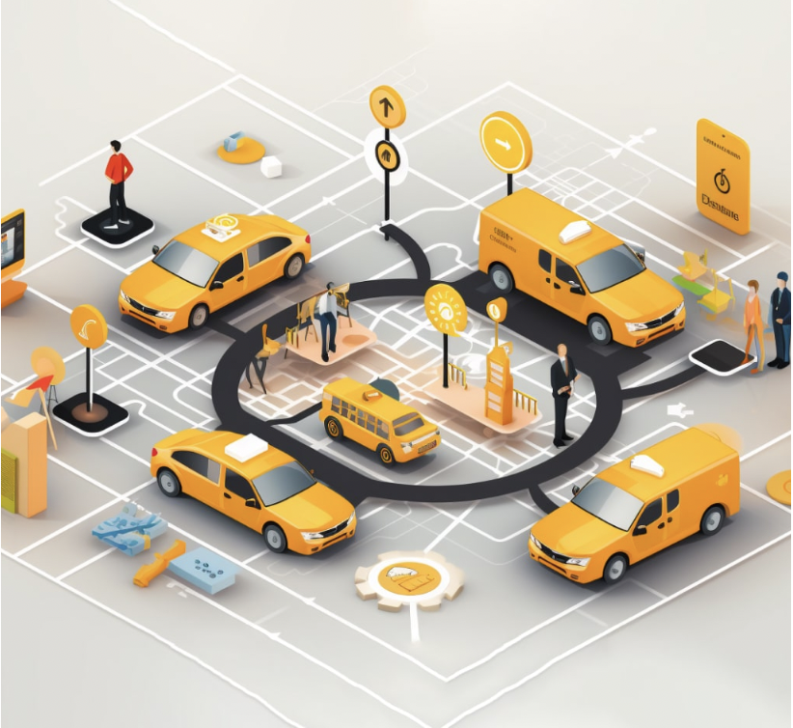
Fleet Management and Ride Pooling Optimisation
Dynamic Vehicle Routing (DVR):
Fleet management systems use dynamic routing algorithms to optimise real-time vehicle-to-passenger assignments.
2. Ride-Pooling:
Ride-pooling optimises vehicle utilisation by combining trips from multiple passengers sharing similar routes.

Slide 22
Alonso-Mora's Anytime-Optimal Method:​
Pruning: Removes infeasible trip combinations.
Assignment: Matches vehicles to optimal passenger requests.
Redistributes idle vehicles to areas with expected future demand.

Slide 23
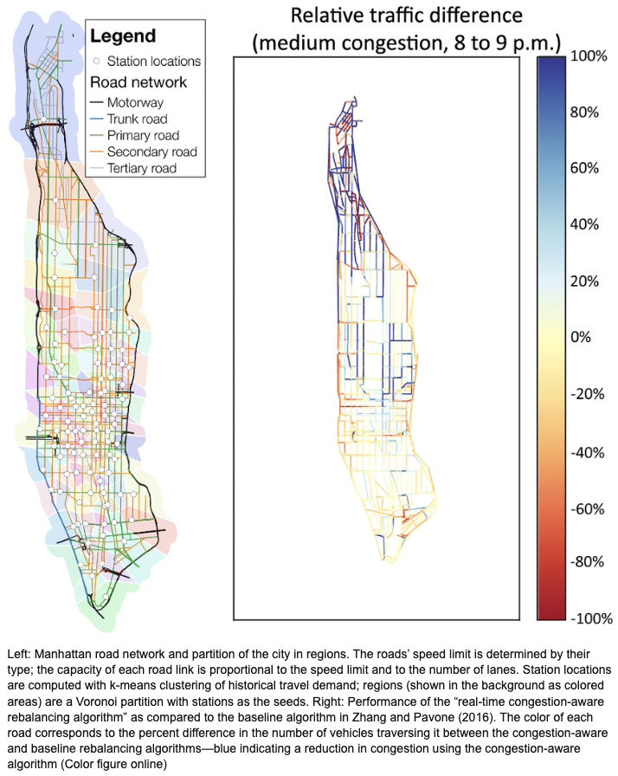
2. Congestion-Aware Routing:​
Congestion-aware routing is a dynamic adjustment of routes in response to traffic conditions, minimising travel times and operational costs.​
Zhang et al.'s method incorporates constrained optimisation to navigate traffic-dense environments efficiently.
It is solved as a Minimum-Cost Multi-Commodity Flow problem, where flows represent vehicles moving across road networks.

Slide 24
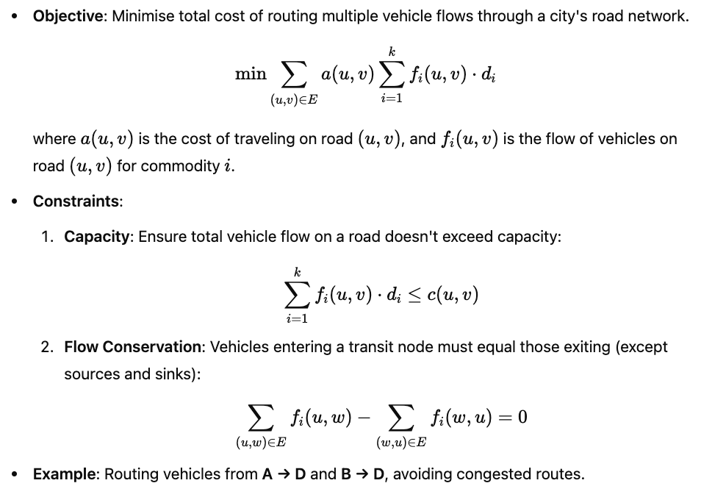
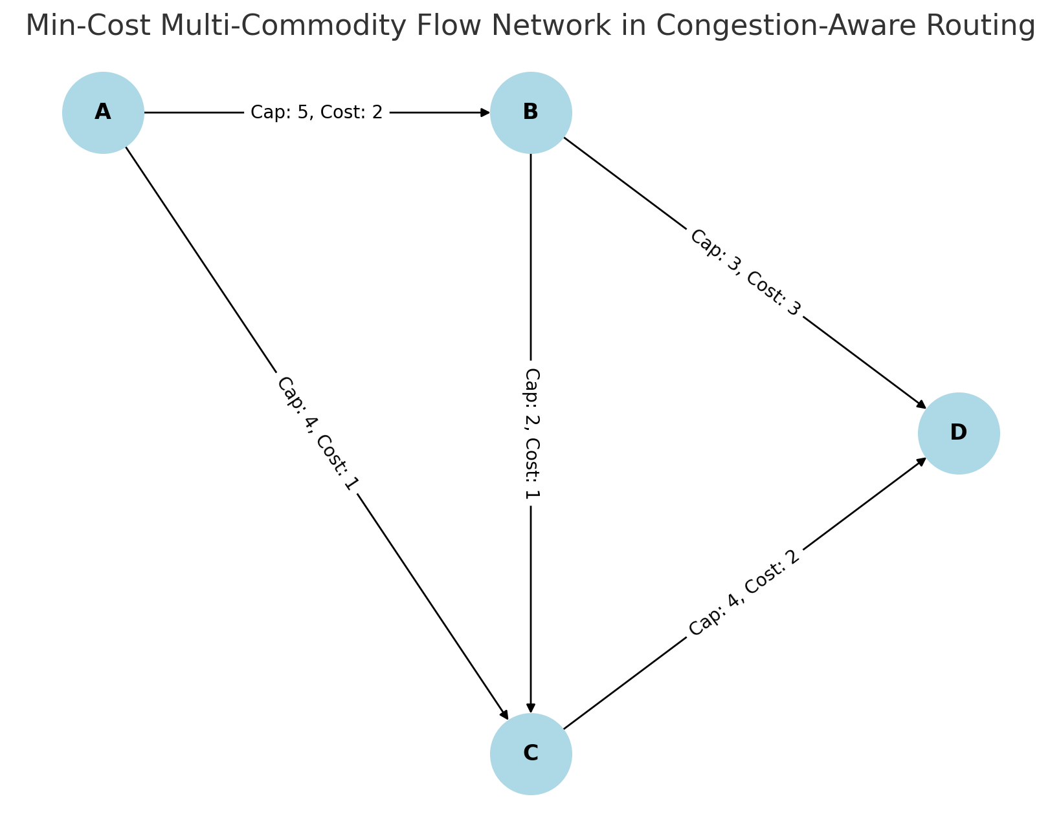
Minimum-Cost Multi-Commodity Flow problem
MCMCF model optimises vehicle routing by minimising travel costs while respecting road capacity and congestion constraints. It dynamically adjusts routes to balance traffic, reducing congestion and improving network efficiency.

Slide 25
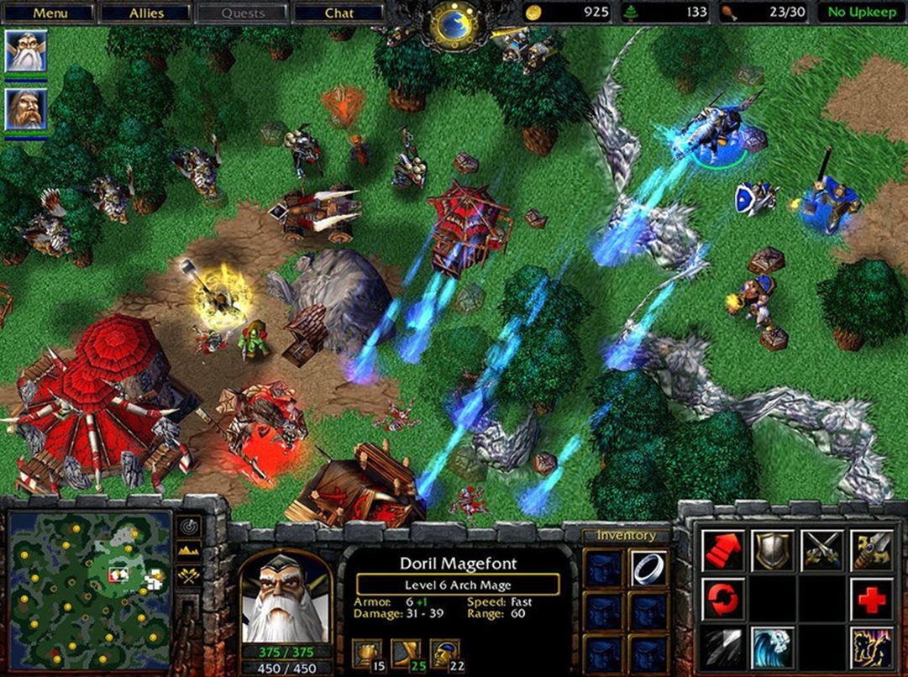

Conclusion
Effective path planning is crucial for navigating both static and dynamic environments.
Advanced optimization techniques improve path planning for complex real-world applications.
Multi-agent systems (RTS games, autonomous vehicles) require solutions for collision avoidance, scalability, and efficiency.
Optimisation is crucial for efficient, safe, and scalable autonomous systems.
Approaches like BVP Path Planner, MCTS, Stackelberg Games, and Dynamic Routing improve decision-making.
Congestion-aware routing reduces traffic and enhances fleet efficiency.
AI-driven techniques drive advancements in ride-sharing and fleet management.

Slide 26
References:
[1] S. Almagor and M. Lahijanian, "Explainable Multi-Agent Path Finding," in Proceedings of the 19th International Conference on Autonomous Agents and Multiagent Systems (AAMAS 2020), Auckland, New Zealand, 2020, pp. 9-13.
[2] D. Silver, "Cooperative pathfinding," in Proceedings of the 1st Artificial Intelligence and Interactive Digital Entertainment Conference (AIIDE), 2005. [Online]. Available: https://www.davidsilver.uk/wp-content/uploads/2020/03/coop-path-AIIDE.pdf
[3] G. Wagner and H. Choset, "Subdimensional expansion for multirobot path planning," Artificial Intelligence, vol. 219, pp. 1-24, 2015. [Online]. Available: https://www.researchgate.net/publication/268695119_Subdimensional_expansion_for_multirobot_path_planning
[4] R. Bentley, "The Starcraft Path-Finding Hack," Code of Honor, 2010. [Online]. Available: https://www.codeofhonor.com/blog/the-starcraft-path-finding-hack
[5] J. Dickinson, "Flowfields for AI pathfinding," JDX Dev, May 3, 2020. [Online]. Available: https://www.jdxdev.com/blog/2020/05/03/flowfields/
[6] E. Furtak, "Path Planning for RTS Games Based on Potential Fields," ResearchGate, 2011. [Online]. Available: https://www.researchgate.net/publication/221252113_Path-Planning_for_RTS_Games_Based_on_Potential_Fields
[7] T. Upadhyay, "All About Gradient Descent and Its Variants," Medium, Dec. 18, 2019. [Online]. Available: https://medium.com/analytics-vidhya/all-about-gradient-descent-and-its-variants-d095be1a833b

Slide 27
[8] L. Salazar, D. Rey, and E. Frazzoli, "Routing autonomous vehicles in congested transportation networks: Structural properties and coordination algorithms," ResearchGate, 2018. [Online]. Available: https://www.researchgate.net/publication/324958215_Routing_autonomous_vehicles_in_congested_transportation_networks_structural_properties_and_coordination_algorithms​
[9] F. Borrelli, P. Falcone, T. Keviczky, J. Asgari, and D. Hrovat, "Autonomous vehicle control: Theoretical foundations and practical challenges," Annual Reviews in Control, 2017. [Online]. Available: https://www.annualreviews.org/content/journals/10.1146/annurev-control-060117-105157​
[10] M. Wolf, P. Daigle, and M. Jamieson, "Monte Carlo Tree Search for Continuous State Spaces," in Robotics: Science and Systems VII, 2010. [Online]. Available: https://www.roboticsproceedings.org/rss07/p34.pdf​
[11] Fleeto, "Fleet management for taxi and ride-sharing fleets," Fleeto, 2023. [Online]. Available: https://fleeto.ae/solutions/fleet-management-for-taxi-and-ride-sharing-fleets/​
[12] GeeksforGeeks, "Monte Carlo Tree Search (MCTS)," GeeksforGeeks, 2023. [Online]. Available: https://www.geeksforgeeks.org/ml-monte-carlo-tree-search-mcts/​
[13] P. Balachandran, "Monte Carlo Tree Search for Materials Design and Discovery," MRS Communications, 2019. [Online]. Available: https://www.cambridge.org/core/journals/mrs-communications/article/monte-carlo-tree-search-for-materials-design-and-discovery/E8CFDE0EEC61B217A59BC42827205CBE​
[14] A. Karagök and S. Balcıoğlu, "Steps of a Stackelberg Game Theory," ResearchGate, 2020. [Online]. Available: https://www.researchgate.net/figure/Steps-of-a-Stackelberg-Game-Theory_fig1_344880267​

Slide 28


